Slide 1
Milestone 4: Proposed Solution Architecture
A Software Application for Construction Waste Minimization
TEAM 4: Wyatt Bushman, Chris Nunez,
Michael Lindemann, Thomas Dalbavie
SPONSOR: Peter Buonaiuto, Built By Peter LLC

Slide 2
Functional Requirement 1:
1 Dimensional Problem
Proposed Solution 1:
Iteratively cut until exhausted all wood then produce graphical output for user to cut.
Proposed Solution 2:
Iteratively cut given hash table (JSON) Example
[
{"length": 2, "quantity": 2},
{"length": 3, "quantity": 1},
{"length": 4, "quantity": 1}
]
Ideal Solution:
A combination of the two proposed solutions to give the user more flexibility in their input.
[
{"length": 2, "quantity": 2},
{"length": 3, "quantity": 1},
{"length": 4, "quantity": “keepGoing=True”}
]

Slide 3
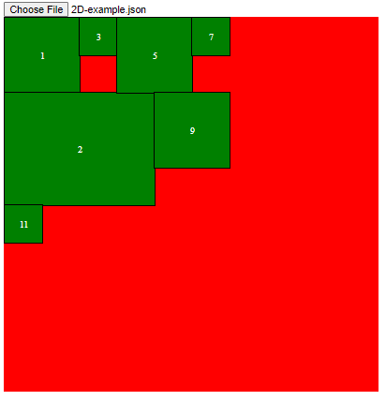
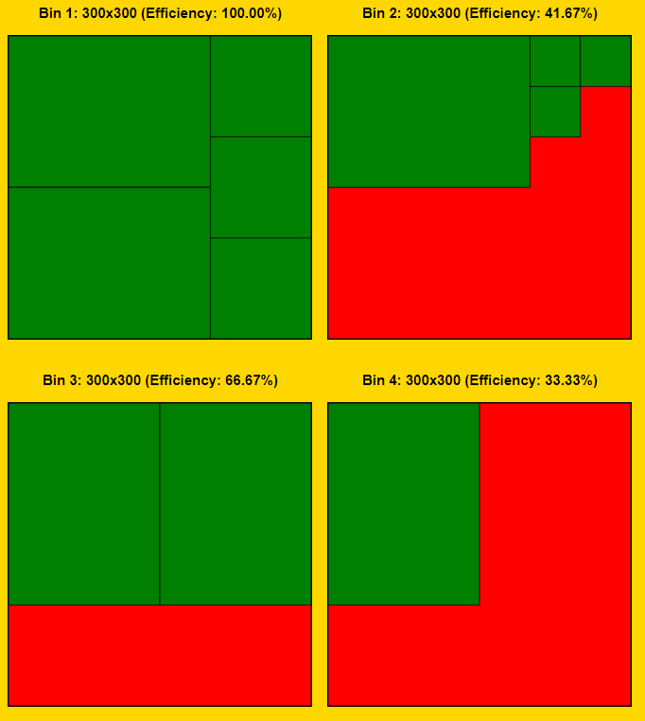
Functional Requirement 2:
2 Dimensional Problem
Proposed Solution 1:
Sort using Shelf algorithm
Proposed Solution 2:
Sort using Guillotine algorithm
Preferred Solution:
Run both Shelf and Guillotine algorithms in parallel. Calculate the total area of waste in both results. Then pick the result with the lowest area of waste and display it to the user. Example Below: Which uses less area?

Slide 4
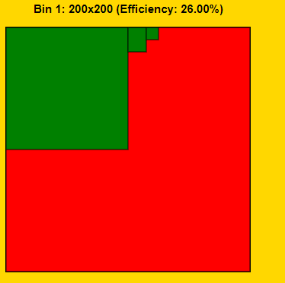
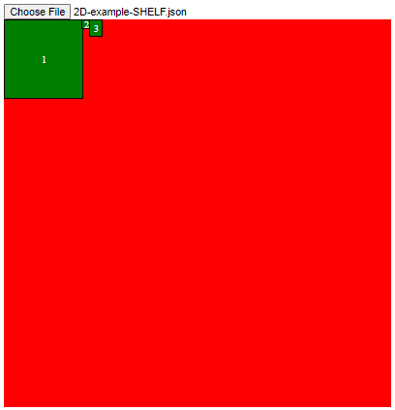
Another example
Working out logic of placing blocks
Shelf vs Guillotine

Slide 5

Functional Requirement 3:
Input Definition
Proposed Solution 1:
Available Presets:
Plank Size
Canvas Size
Blade Thickness
Proposed Solution 2:
Custom Sizes
Fine precision for sizes
Supports any blade thickness
Proposed Solution 3:
Bulk input using JSON files as input
Ideal Solution:
A combination of each solution.
Solution 1: simplicity for entry level users.
Solution 2: Extensiveness for power users or professionals.
Solution 3: Bulk inputs for large scale inputs.

Slide 6
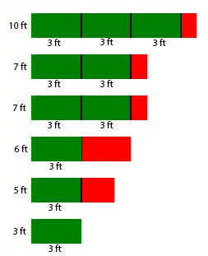
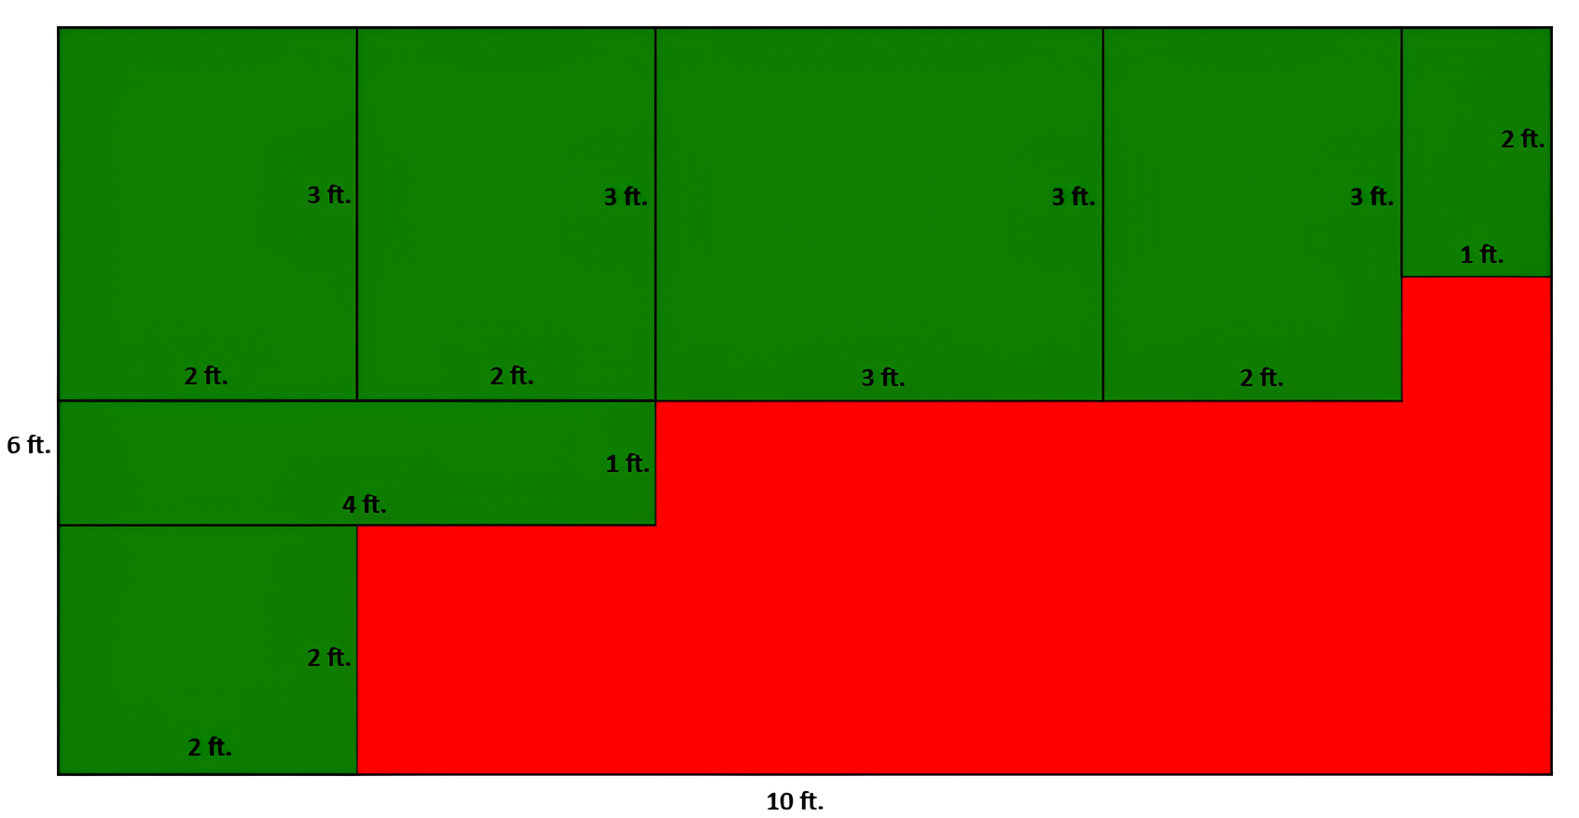
Functional Requirement 4:
Output and Visualization
Proposed Solution:
Provide labels for cut sizes.
Take into account saw blade thickness.
Differentiate area that should be kept vs waste area (the red).
Example of 2D output:
Example of 1D output:

Slide 7
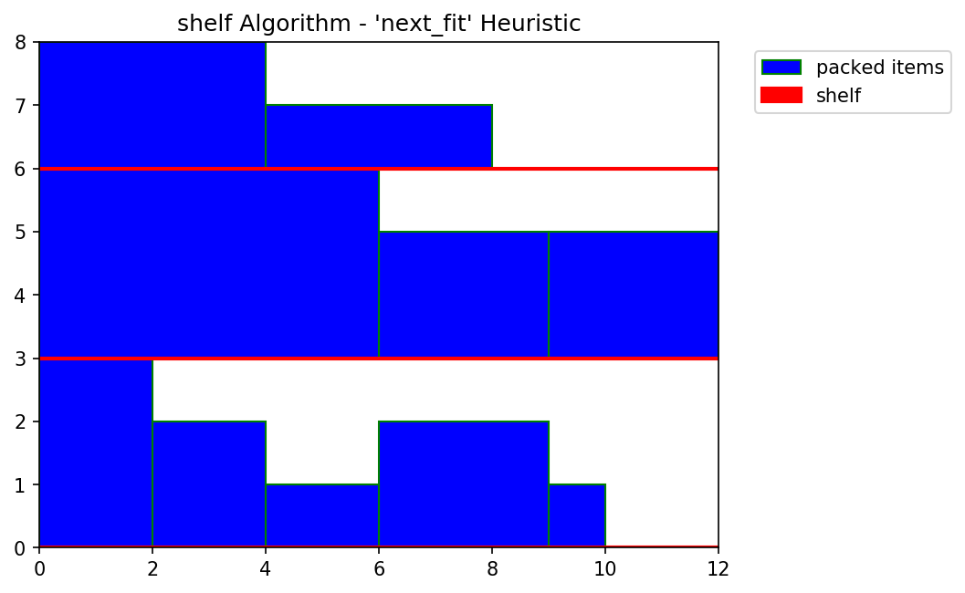
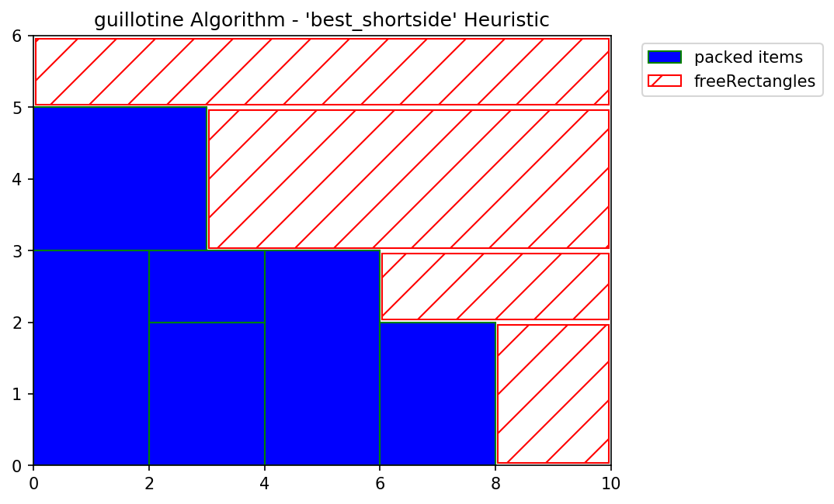
Functional Requirement 5:
Waste Minimization
Proposed Solution (only applies to 2D):
Runs Guillotine and Shelf algorithm in parallel and select the best result.
Uniform shapes tend to get better results from the Guillotine algorithm
Does not have to worry about shelves that could waste more space.
Larger variance in shapes may have better results with the Shelf algorithm
Shelves can provide better sorting for blocks that have more variance.

Slide 8
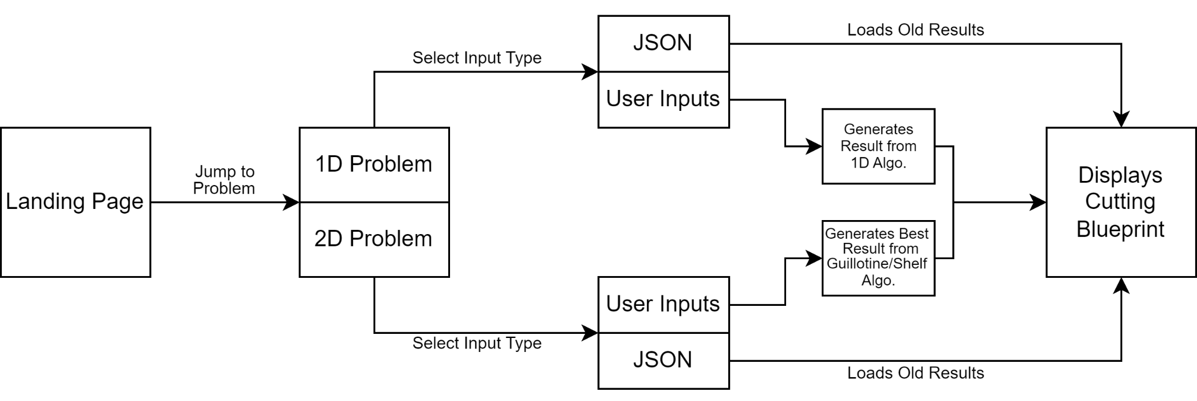
System Flow Diagram
Everything is built on one webpage.
Ability to save blueprint and load it up again using JSON files.
User inputs consist of:
Cut sizes (Predefined sized defined by most commonly used sizes)
Canvas sizes (Predefined sized based on standard sizes available)
Blade thickness (Predefined thicknesses based on industry standards)

Slide 9
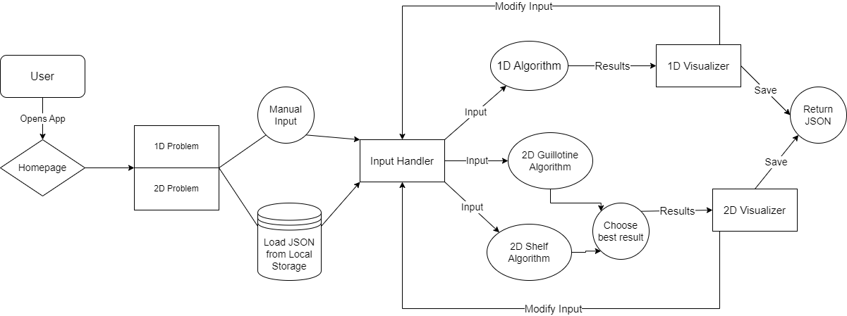
Data Flow Diagram
User can choose between entering input manually or from local storage.
Our 2D model chooses between the Shelf and Guillotine algorithms to find the best solution
After the results are returned, the user has the choice between modifying the inputs and saving the given results

Slide 10
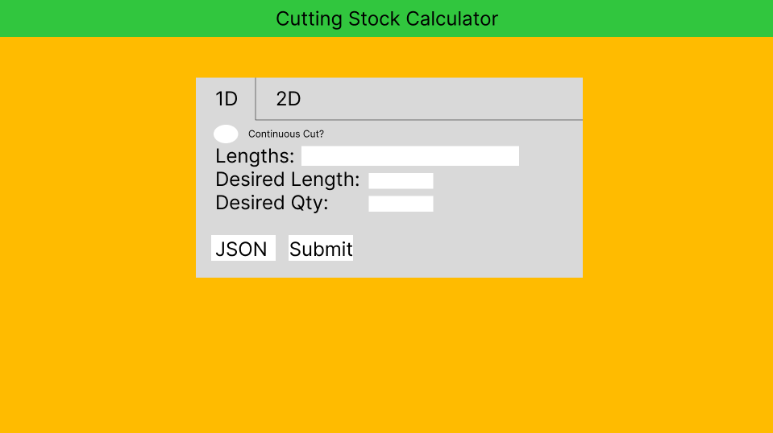
1D Selected Manual Entry Hashmap

Slide 11
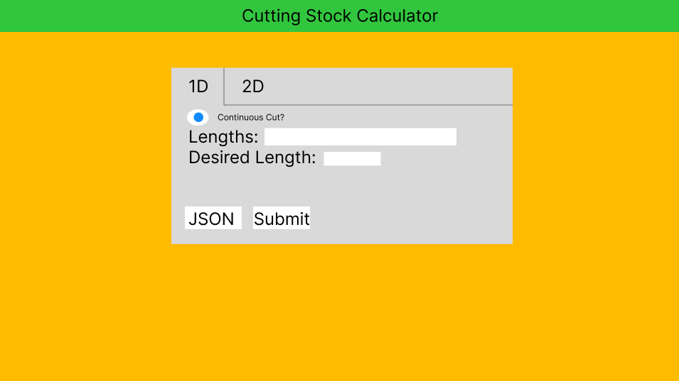
1D Selected & Continuous Cut

Slide 12
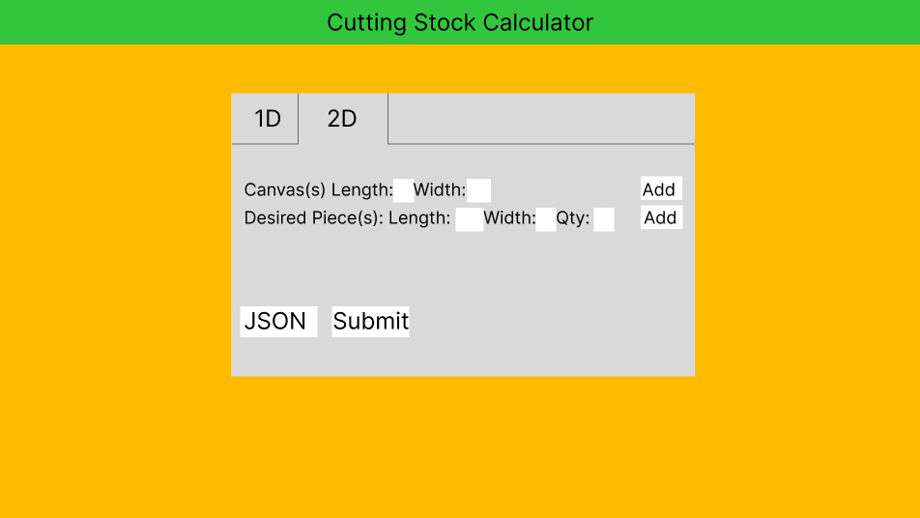
2D Option Selected

Slide 13
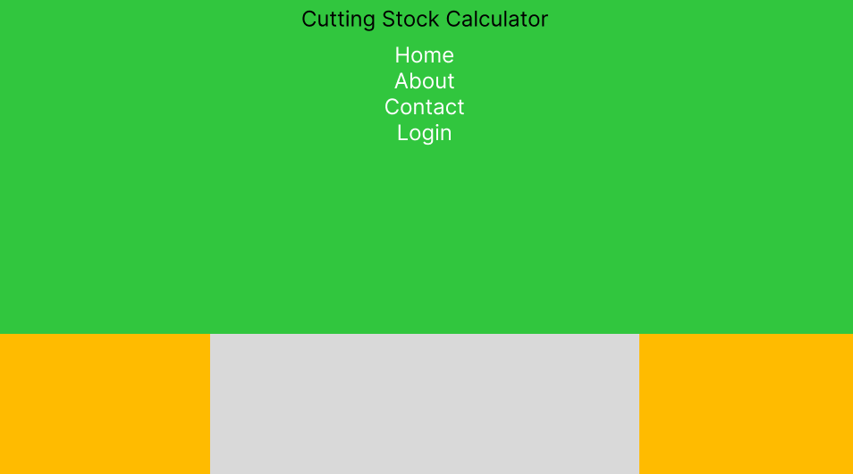
Navbar Dropdown

Slide 14
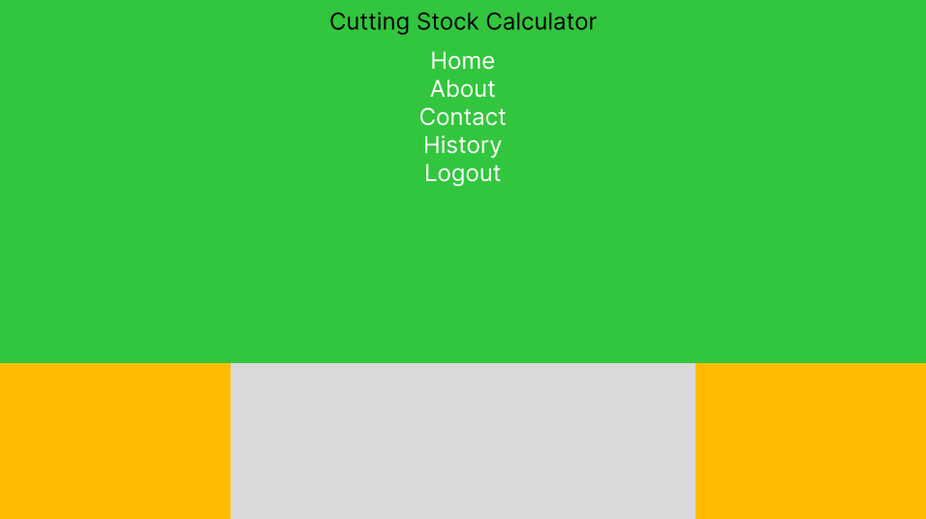
After Logging In, Access To History Of Work

Slide 15
Thank You!
Any Questions?

